Slide 1
2 Breeding cage:Cx3cr1 x WT 1 Breading cage:Tmem119 x WT

Slide 2
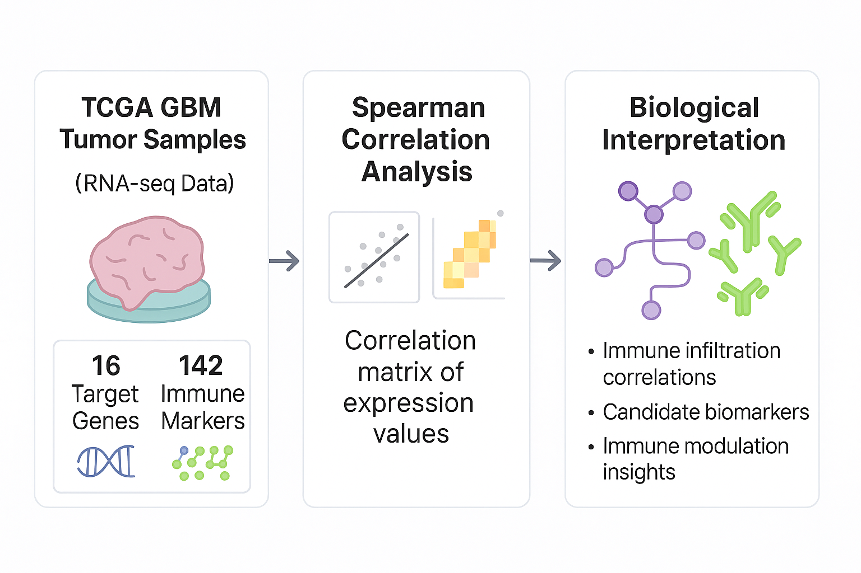
Total GBM correlations: 1,460/2272 (FDR < 0.05)
Unique target genes: 16
Unique immune markers: 142
25.08.20

Slide 3
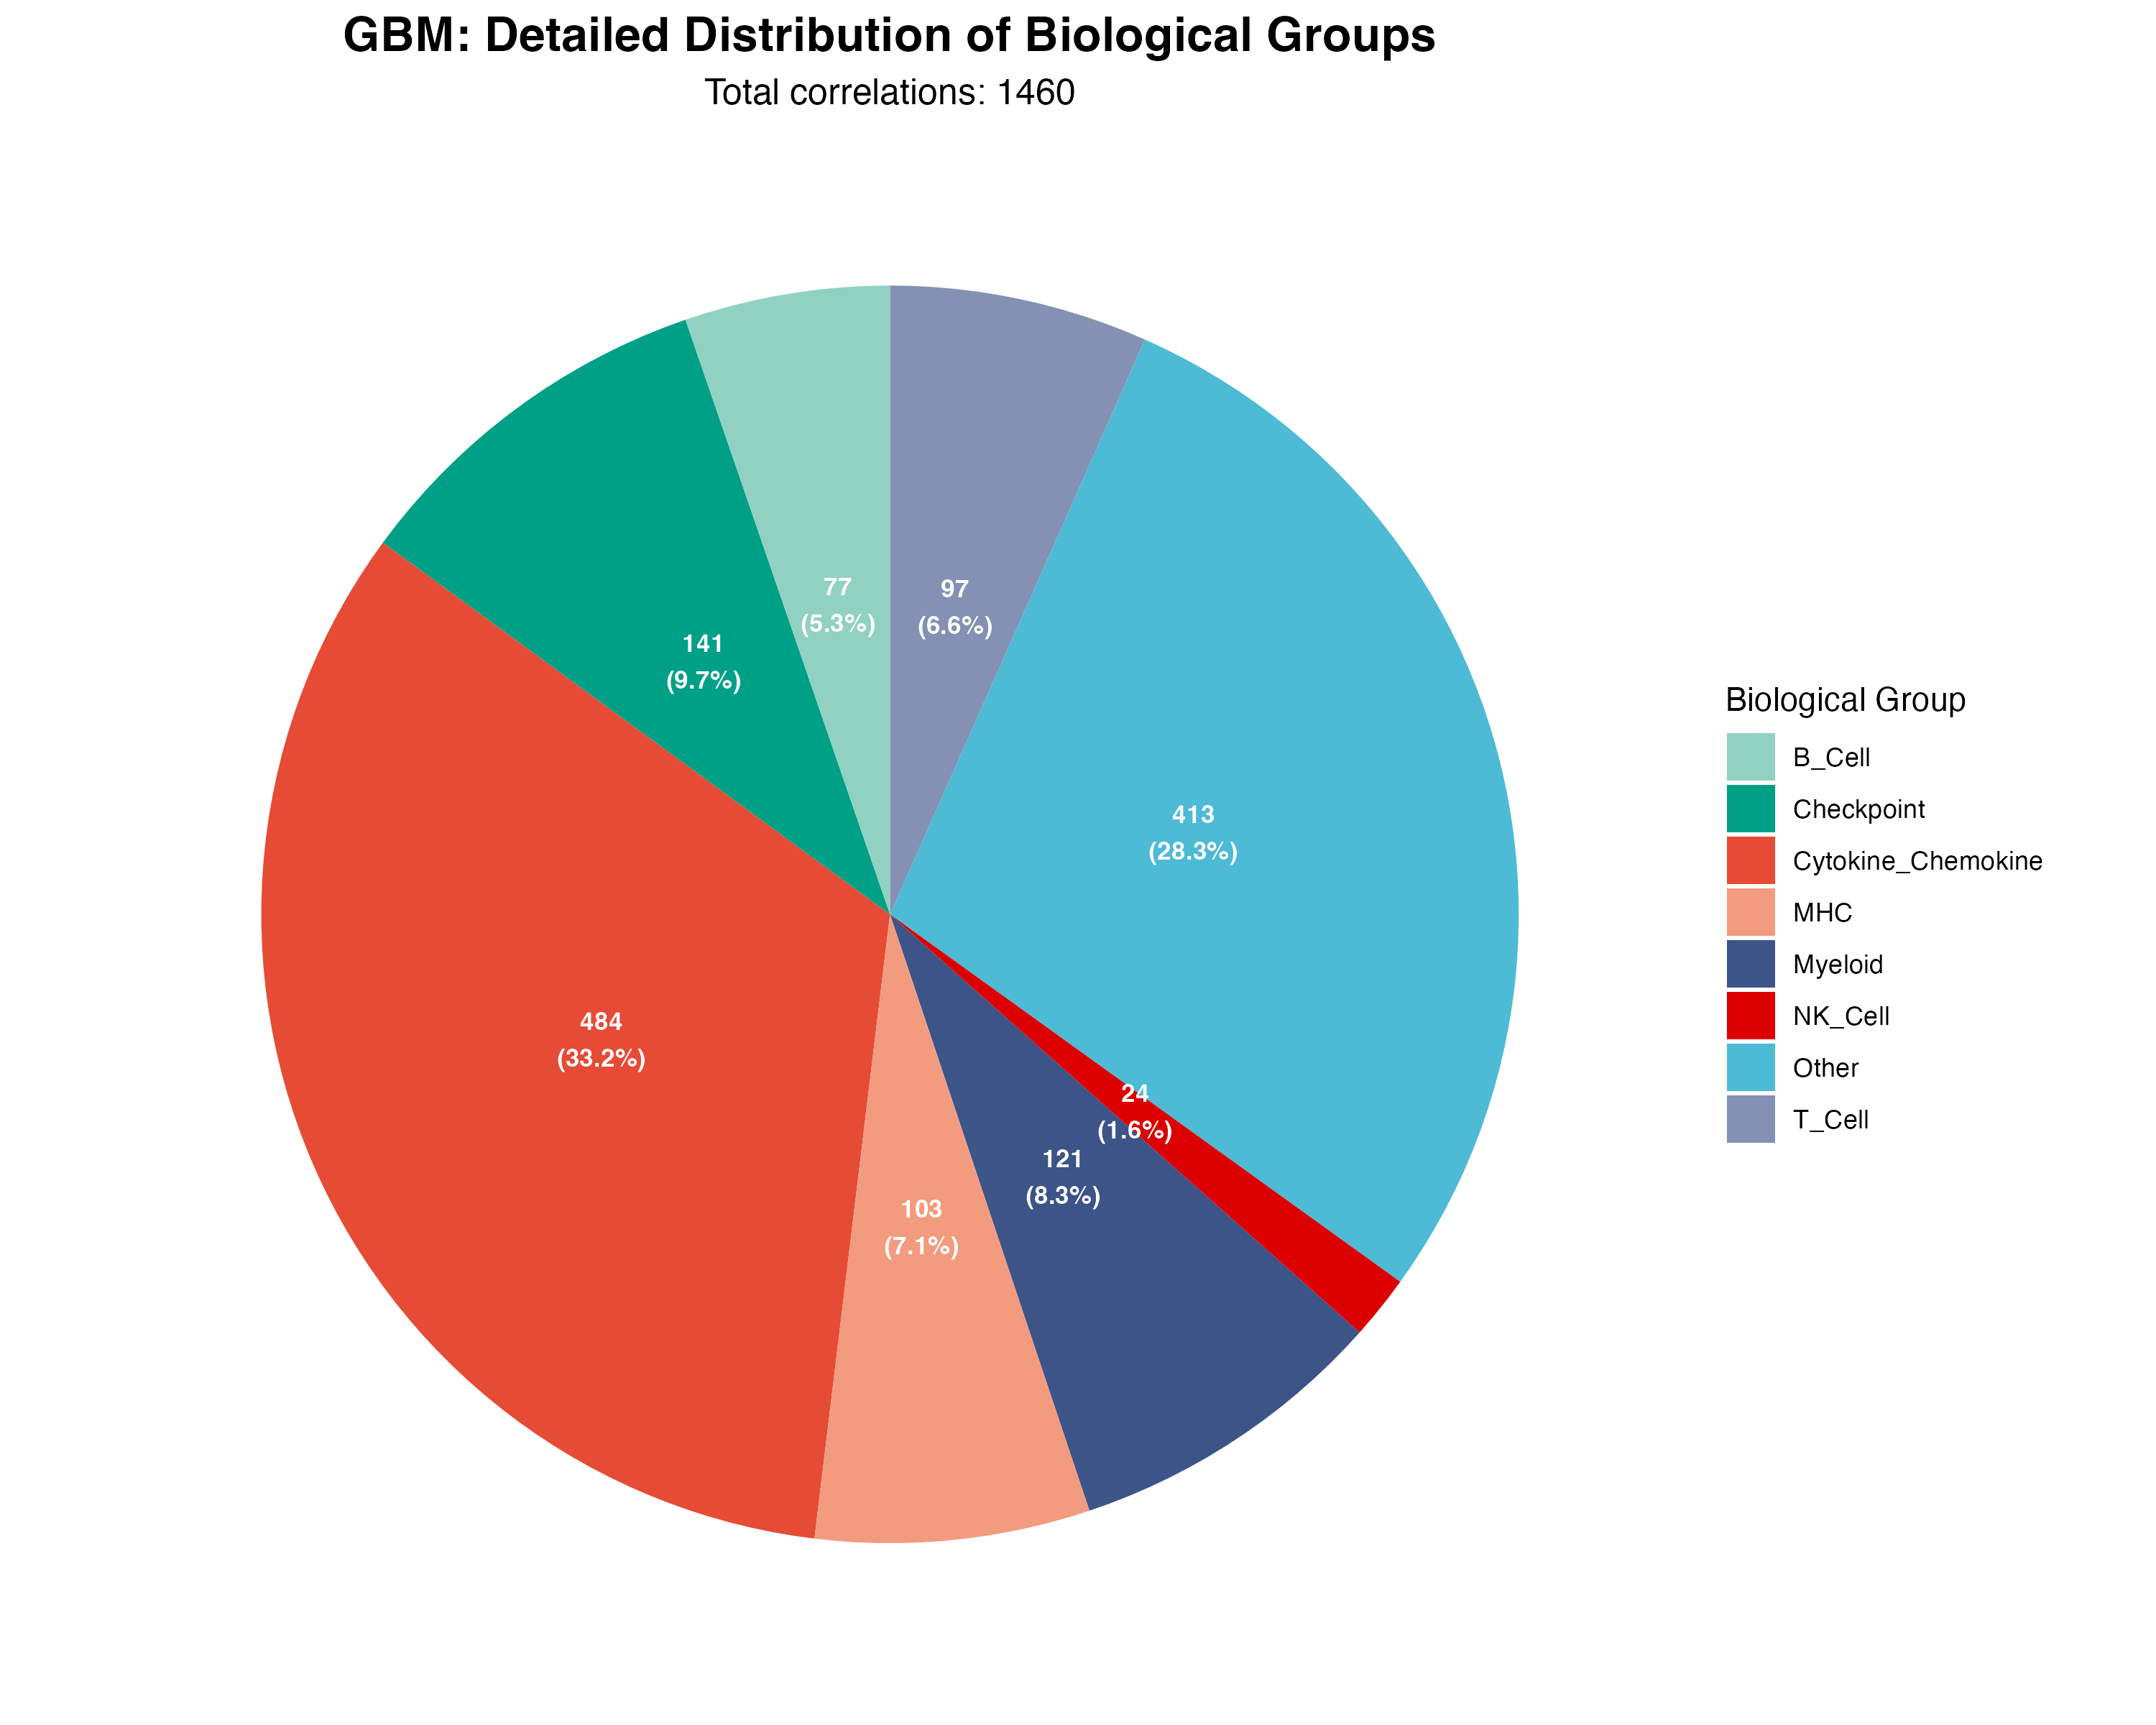
25.08.20

Slide 4
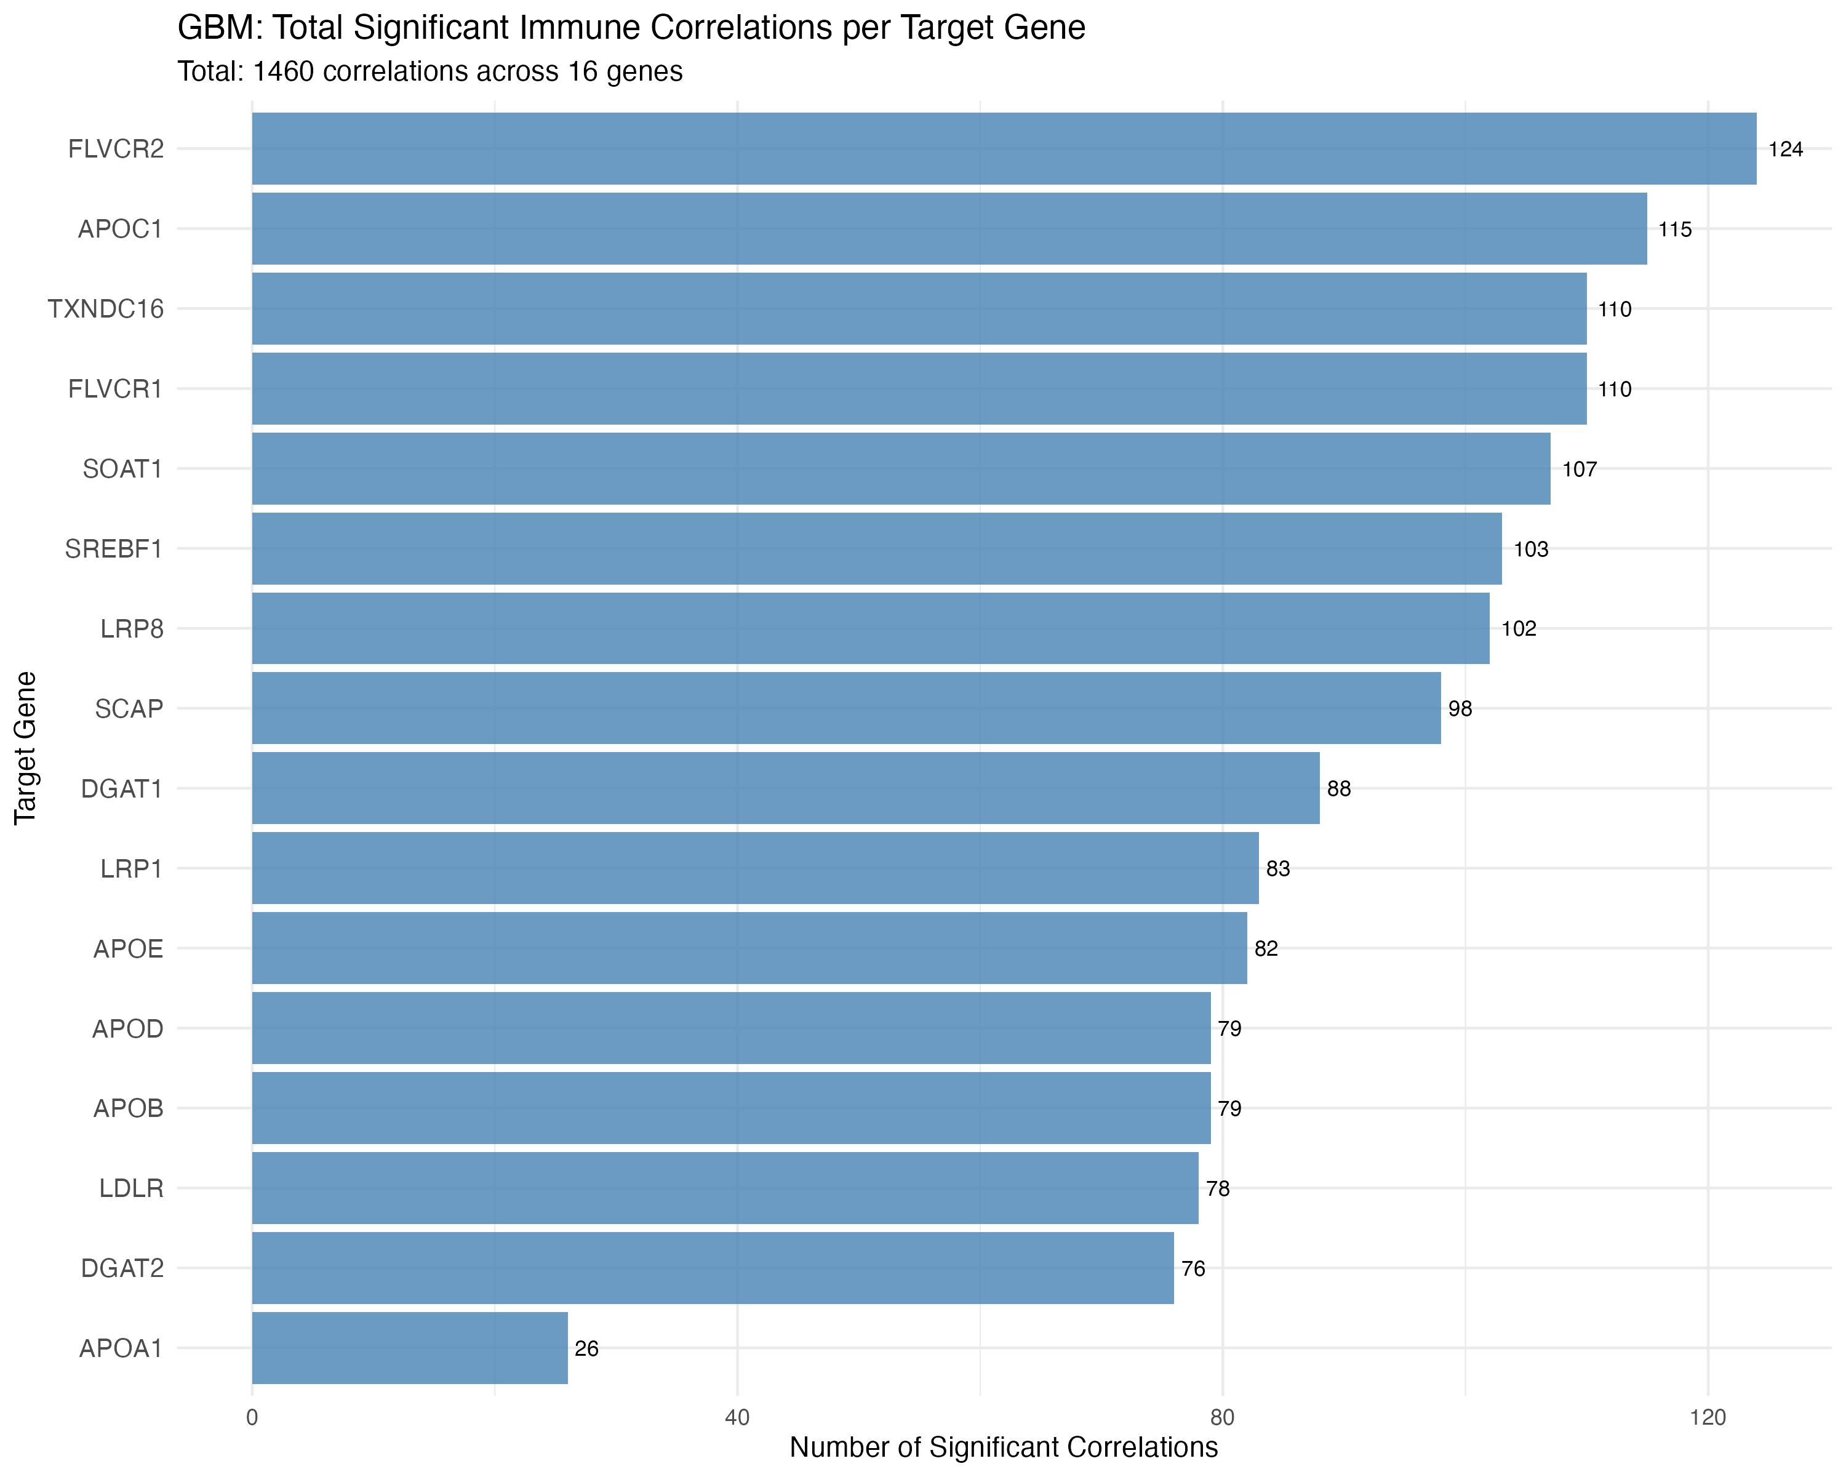
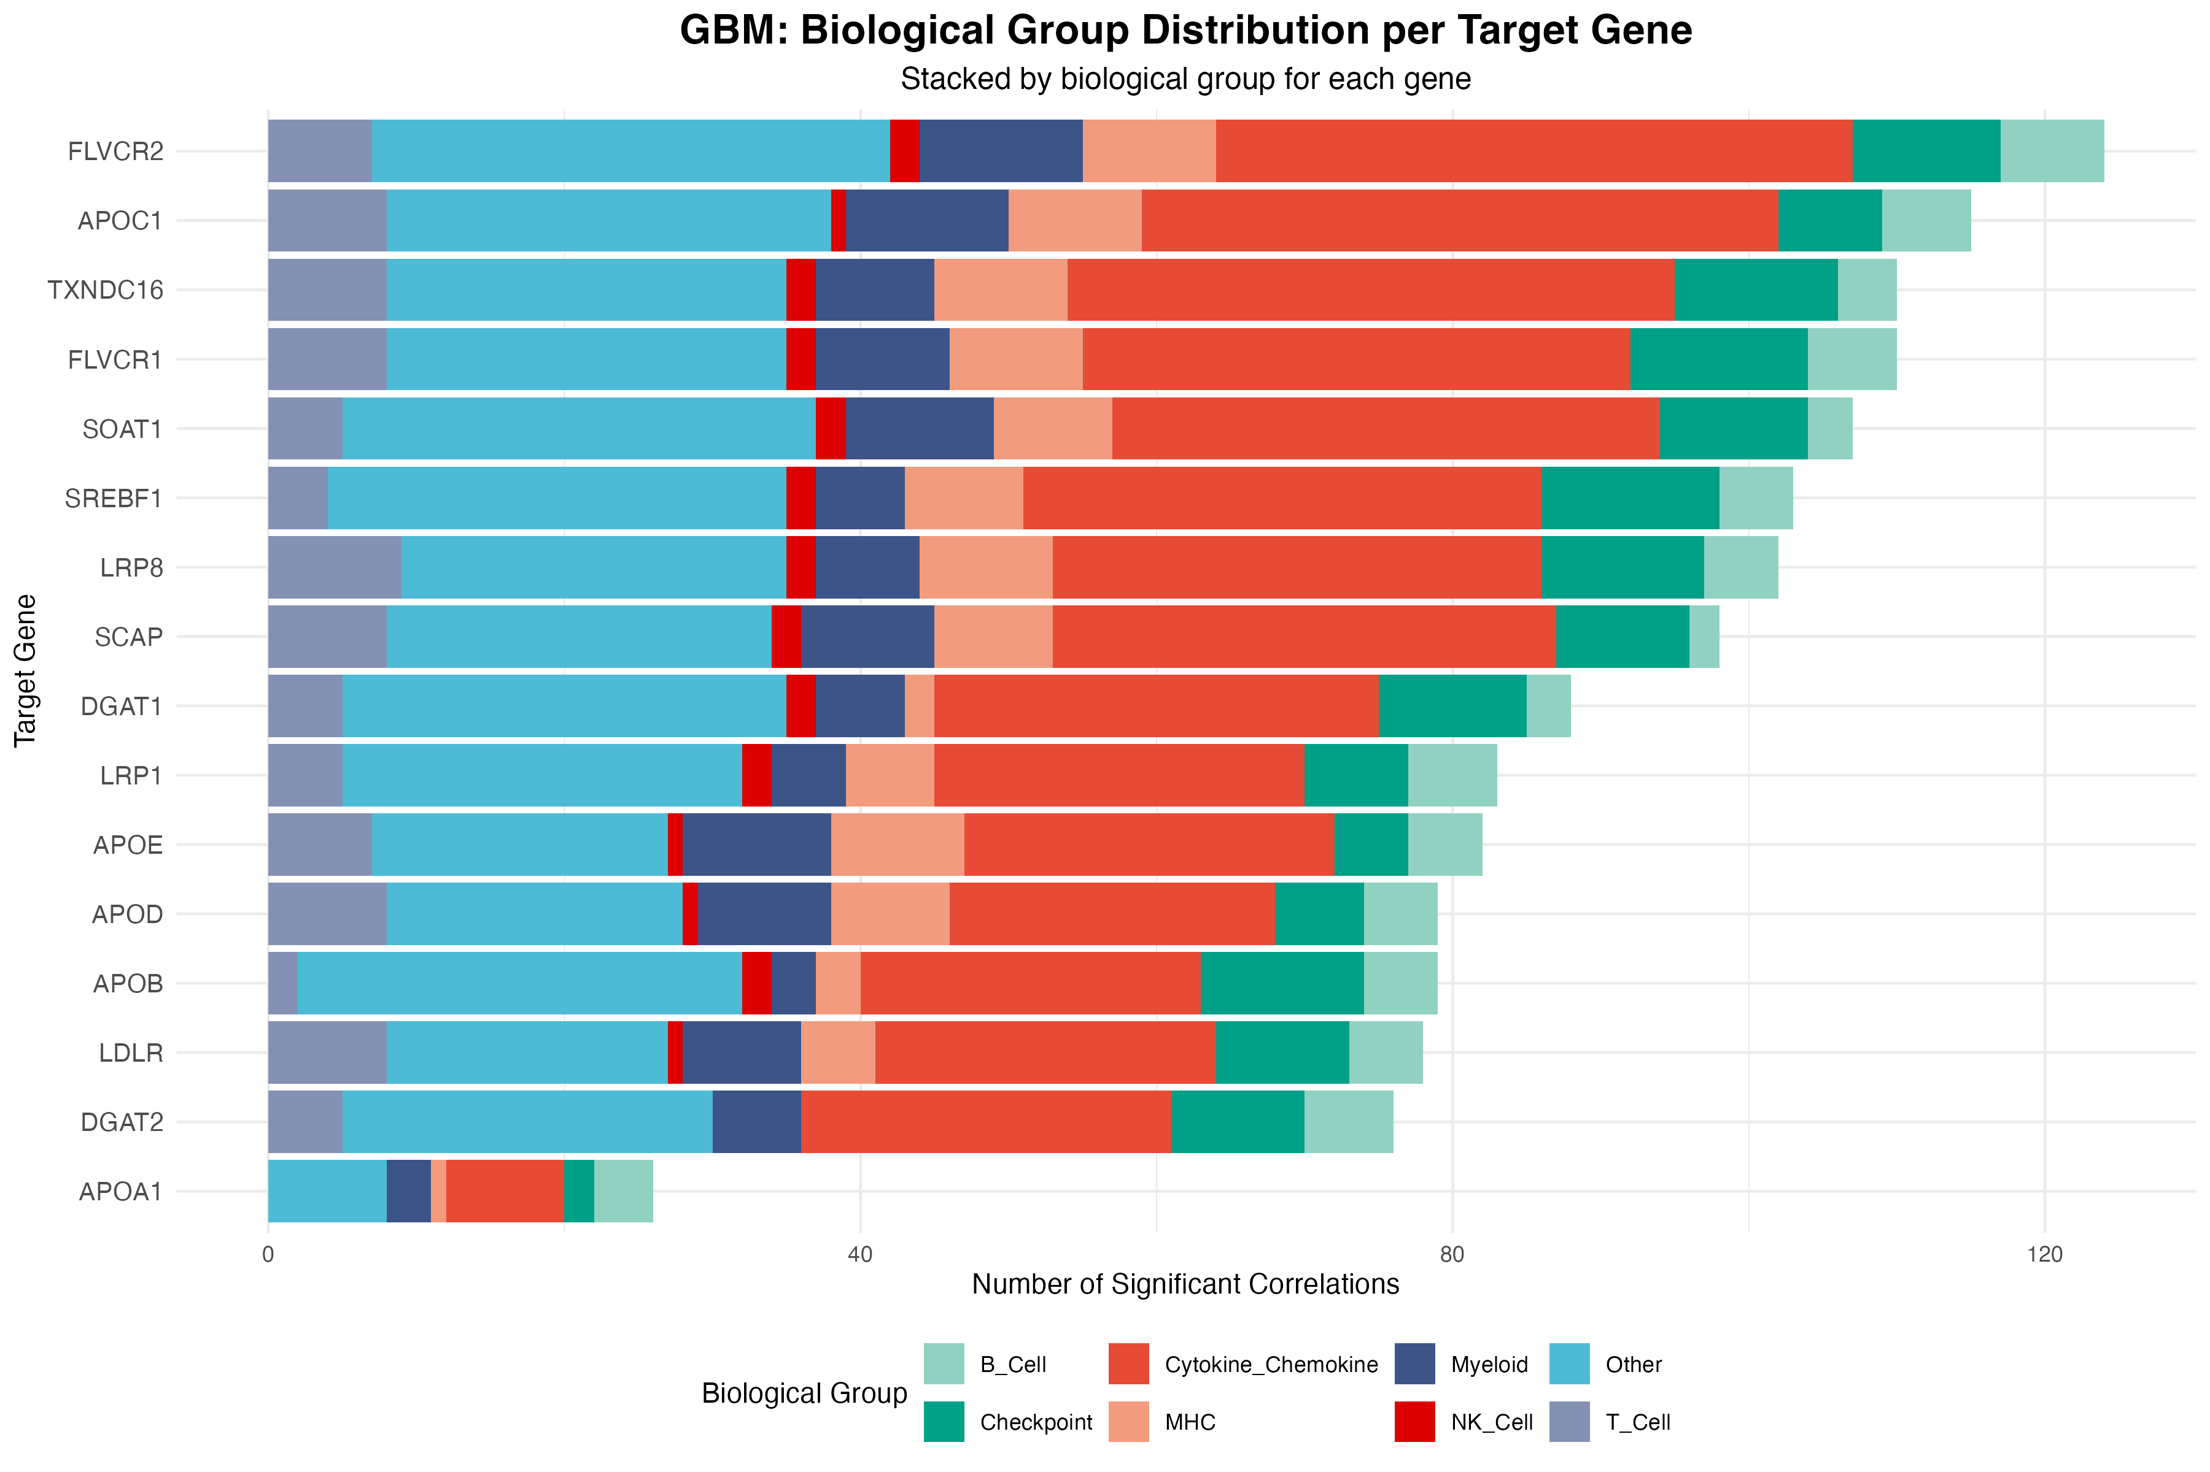
25.08.20

Slide 5
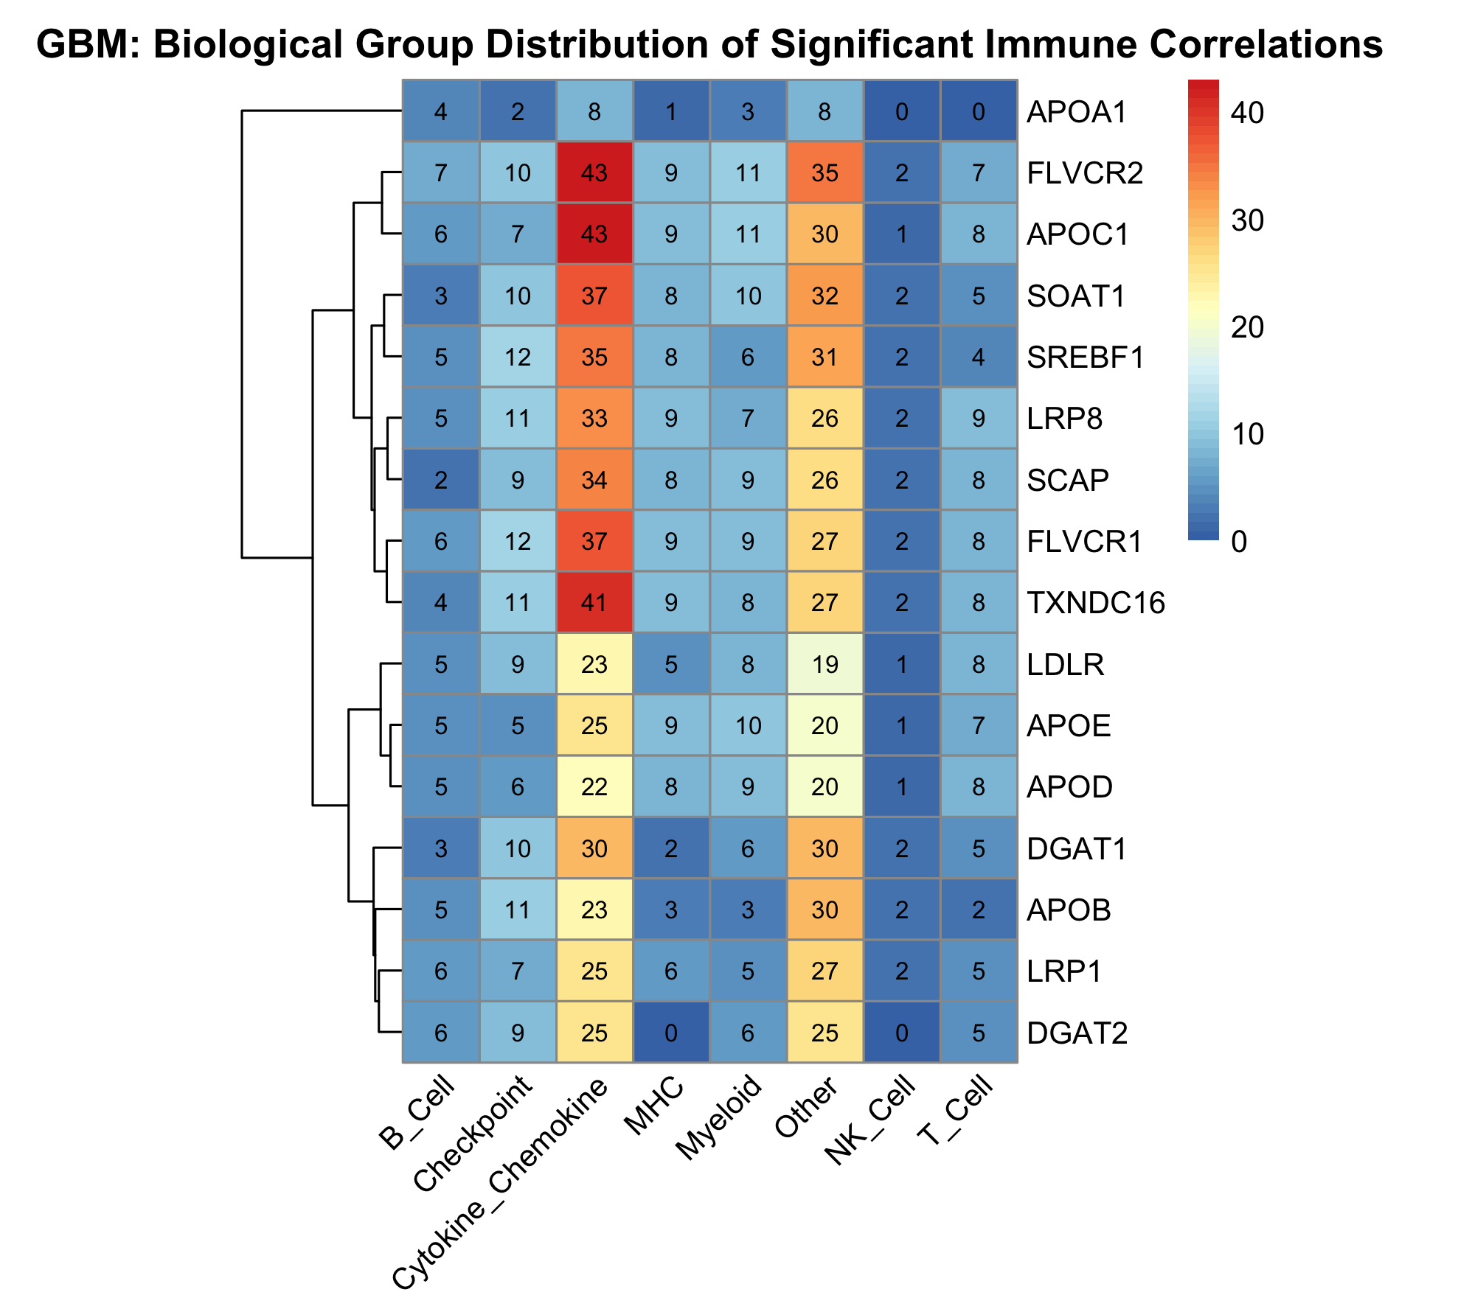
Cytokine_Chemokine: ~50 markers
Other: ~40 markers
Checkpoint: 13 markers
Myeloid: 11 markers
MHC: 9 markers
T_Cell: 9 markers
B_Cell: 8 markers
NK_Cell: 3 markers
25.08.20

Slide 6
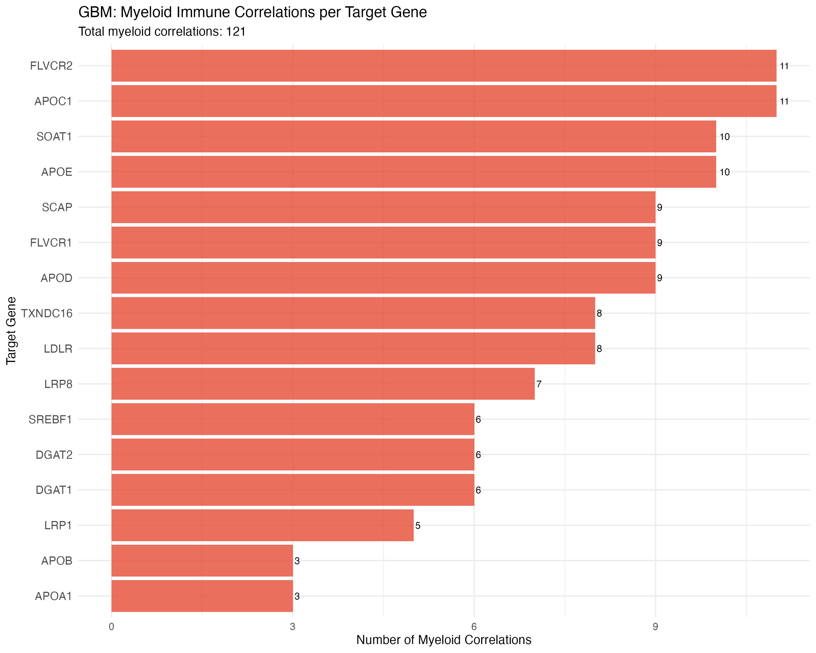
MYELOID MARKERS(11 markers in total):
25.08.20

Slide 7
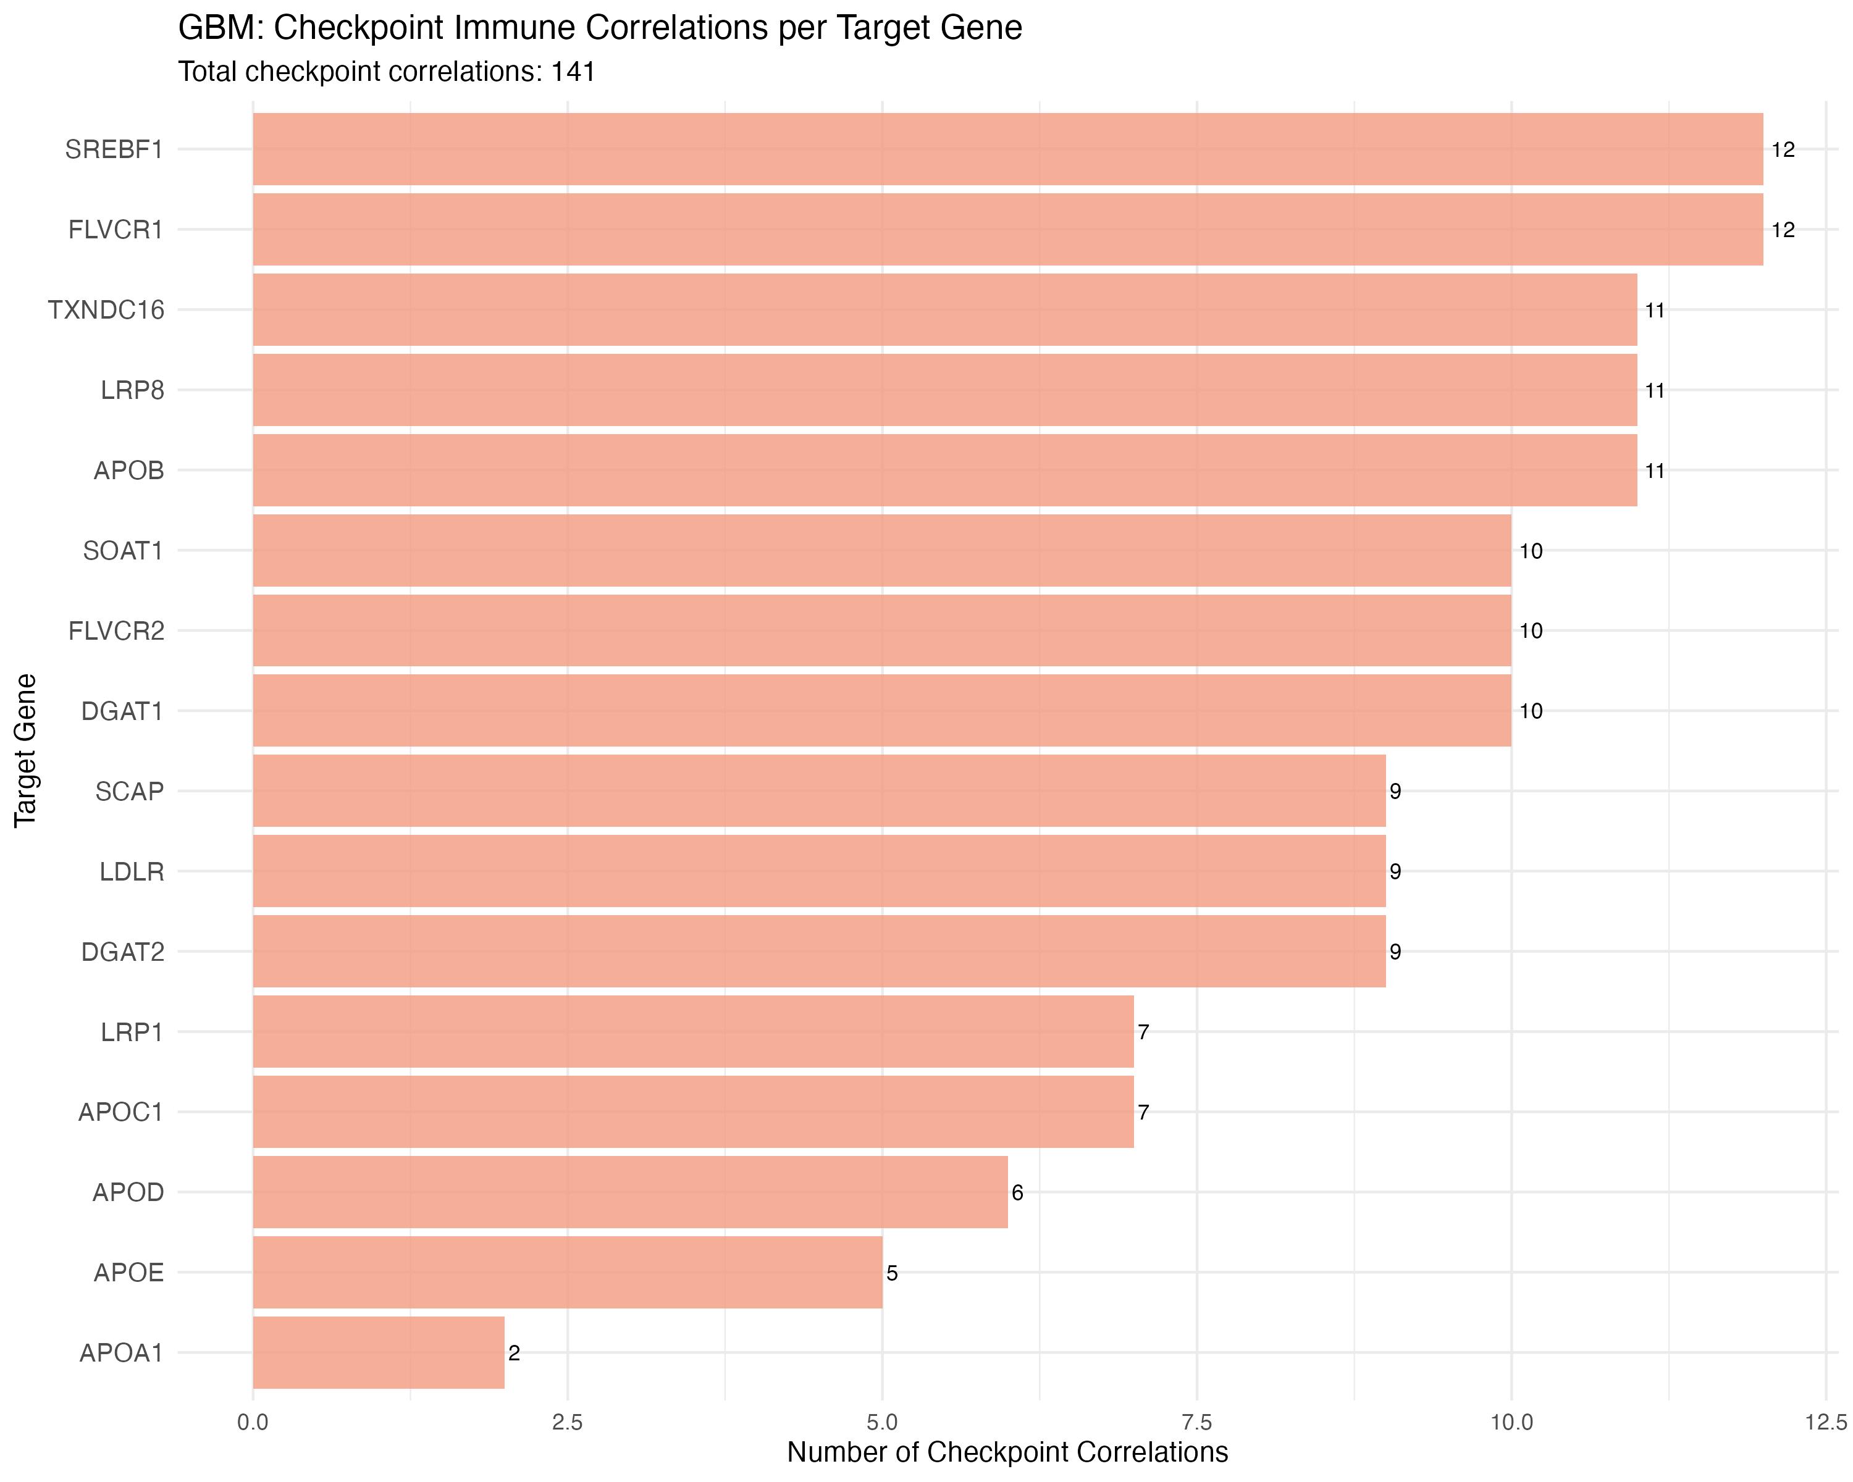
CHECKPOINT MARKERS(13 markers in total
25.08.20

Slide 8
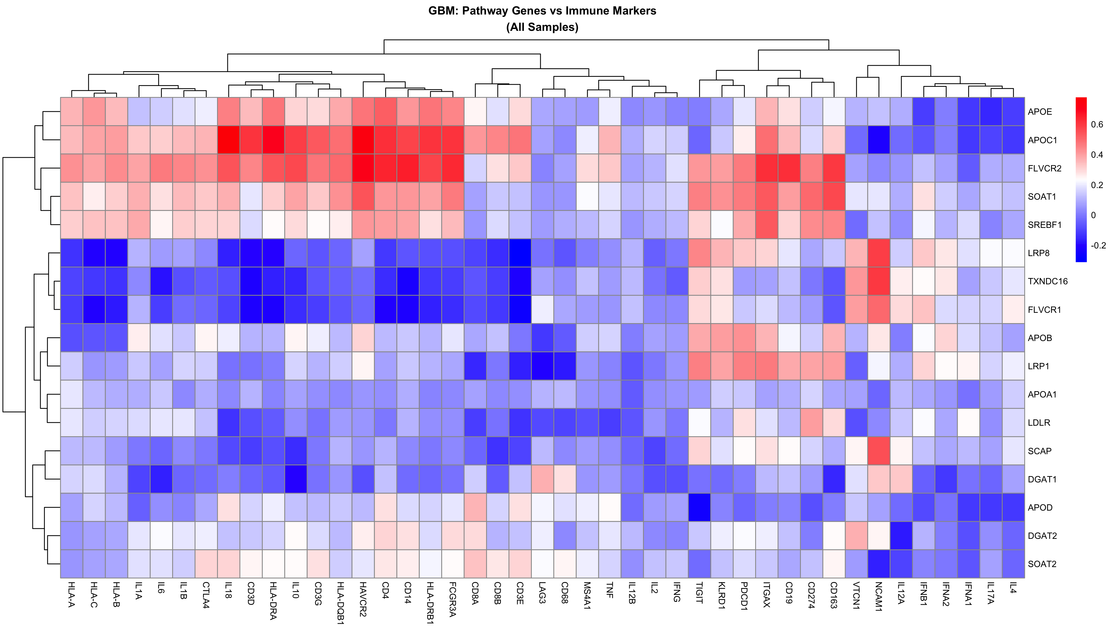
25.08.18

Slide 9
Dataset Overview
This is a DNA genomic dataset from the 1000 Genomes Project
Data Type: DNA (Not mRNA)
Source: 1000 Genomes Project Phase 3 data
Download: Automated download of chromosome 19 VCF file
Format: Phased genotype data in VCF format with 2,504 individuals

Slide 10
#### Haplotype Frequencies
| Haplotype | Count | Frequency | Percentage |
|-----------|-------|-----------|------------|
| ε3 | 3,879 | 0.775 | 77.5% |
| ε4 | 753 | 0.150 | 15.0% |
| ε2 | 375 | 0.075 | 7.5% |
| ε1 | 1 | 0.0002 | 0.02% |
#### Genotype Frequencies
| Genotype | Count | Frequency | Percentage |
|----------|-------|-----------|------------|
| ε3/ε3 | 1,525 | 0.609 | 60.9% |
| ε3/ε4 | 547 | 0.218 | 21.8% |
| ε2/ε3 | 282 | 0.113 | 11.3% |
| ε4/ε4 | 70 | 0.028 | 2.8% |
| ε2/ε4 | 65 | 0.026 | 2.6% |
| ε2/ε2 | 14 | 0.006 | 0.6% |
| ε1/ε4 | 1 | 0.0004 | 0.04% |
#### Carrier Rates
- **ε4 carriers**: 27.3% (683/2,504 individuals)
- **ε2 carriers**: 14.4% (361/2,504 individuals)
### Population Differences
#### ε4 Carrier Rates by Population
| Population | Sample Size | ε4 Carrier Rate | Percentage |
|------------|-------------|-----------------|------------|
| AFR (African) | 661 | 0.461 | 46.1% |
| EUR (European) | 503 | 0.288 | 28.8% |
| AMR (American) | 347 | 0.202 | 20.2% |
| EAS (East Asian) | 504 | 0.165 | 16.5% |
| SAS (South Asian) | 489 | 0.164 | 16.4% |

Slide 11
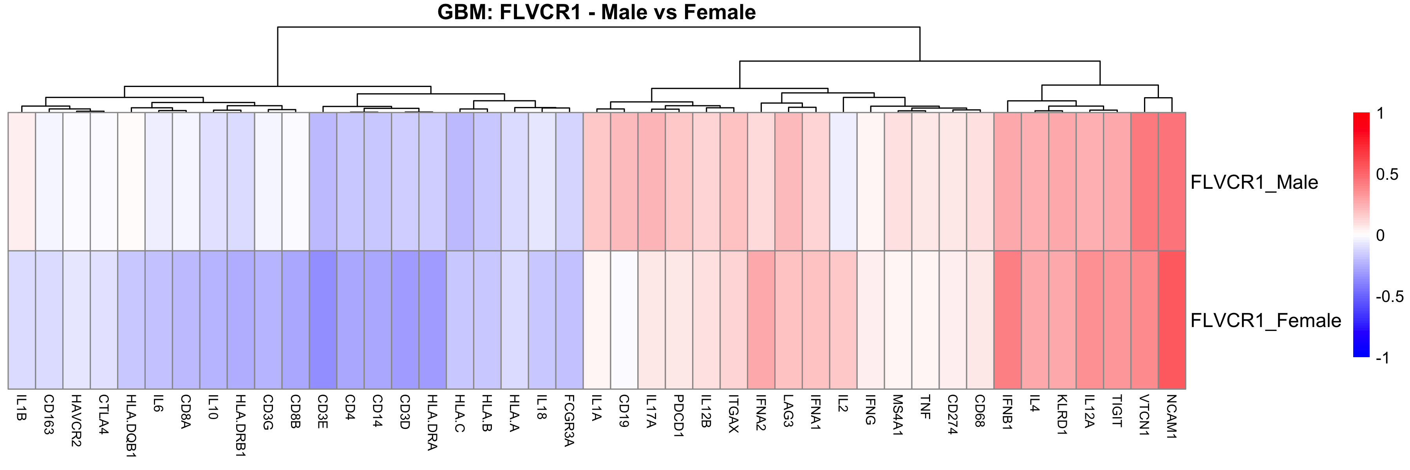
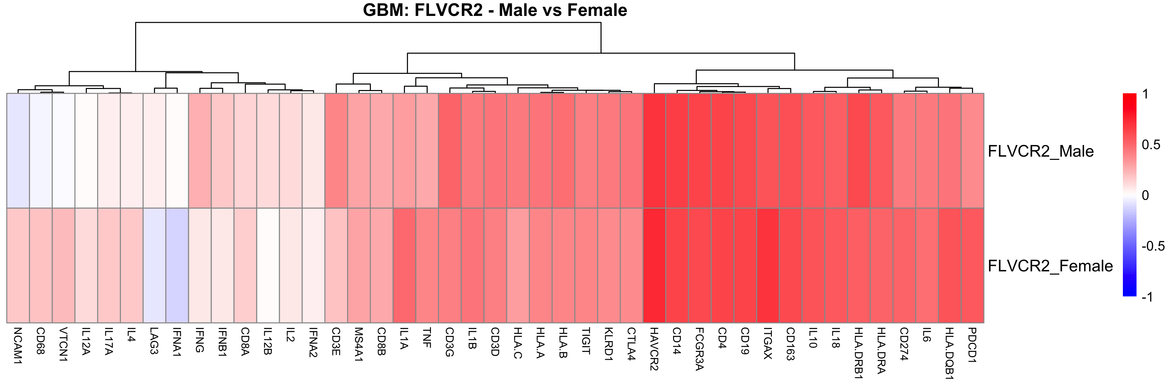
25.08.18

